Slide 1
My Family Health Portrait (MFHP) – HealthVault Import/Export Project
Requirements Review (Draft)
Prepared for
The Department of Health & Human Services &
The National Cancer Institute
October 18, 2009

Slide 2
Background
Based on
  Version 2.3 Use Cases
    User Exports MFHP Data to HealthVault
    User Imports HealthVault Data from HealthVault
  Inception phase Gap Analysis
  Deployed version of MFHP
Basis for
  Requirements discussion
  Wireframe creation
  Initial planning

Slide 3
Overview
Current/Future functionality
  Summary
  Navigation map
  Screendumps/Page mockups
Risks
Next Steps

Slide 4
Current functionality summary
Create/Edit MFHP
Save/Open MFHP (.xml file)

Slide 5
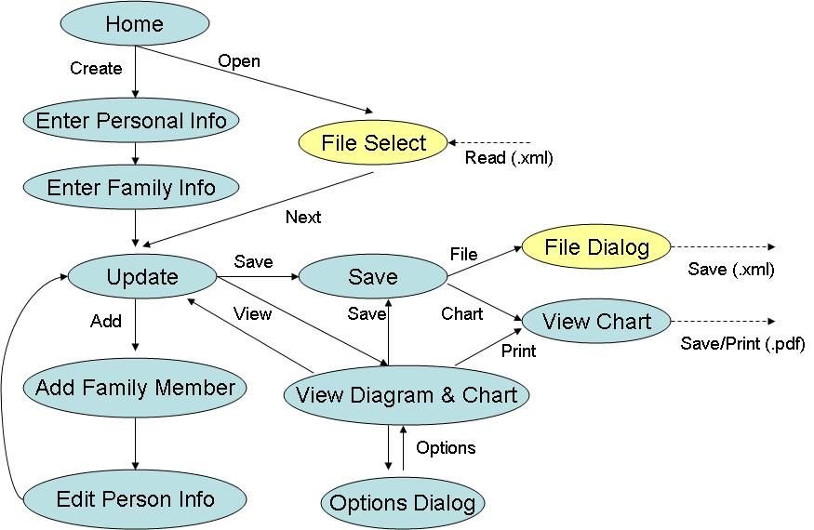
Current navigation map

Slide 6

Current screen: HOME

Slide 7
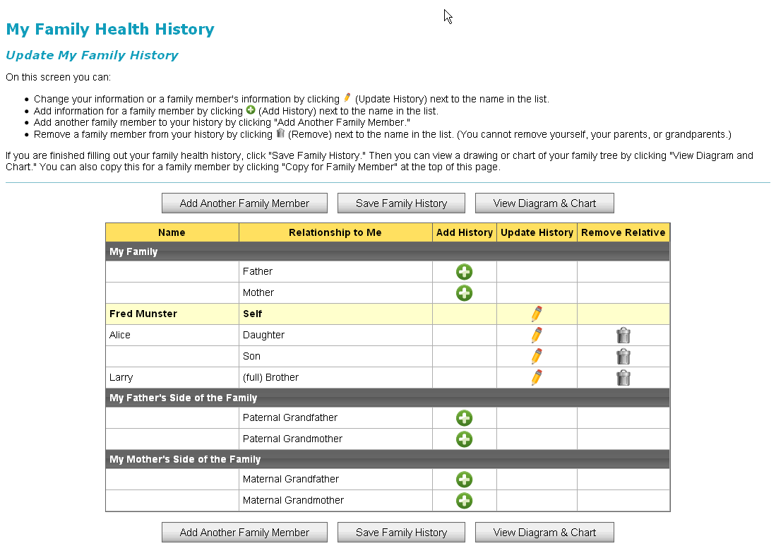
Current screen: UPDATE

Slide 8
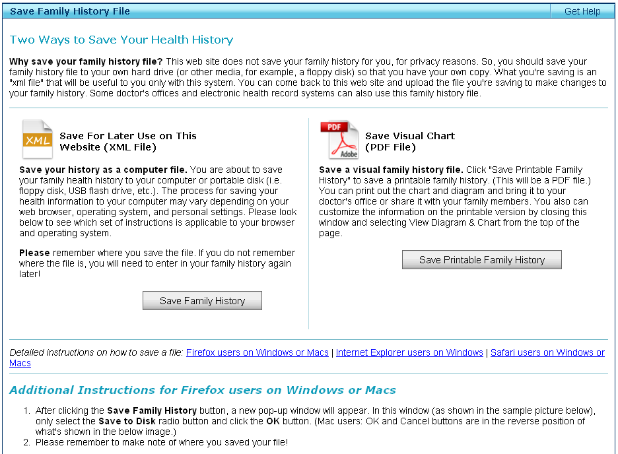
Current screen: SAVE

Slide 9
Future functionality summary
Create/Edit MFHP
  Changes to accommodate MFHP- HVFH translation (see gap analysis)
Save/Open MFHP
  Native MFHP format (.xml file)
  Third party format
    HealthVault Family History (HVFH)
Login/Logout HealthVault (assumes user already has HealthVault account)

Slide 10
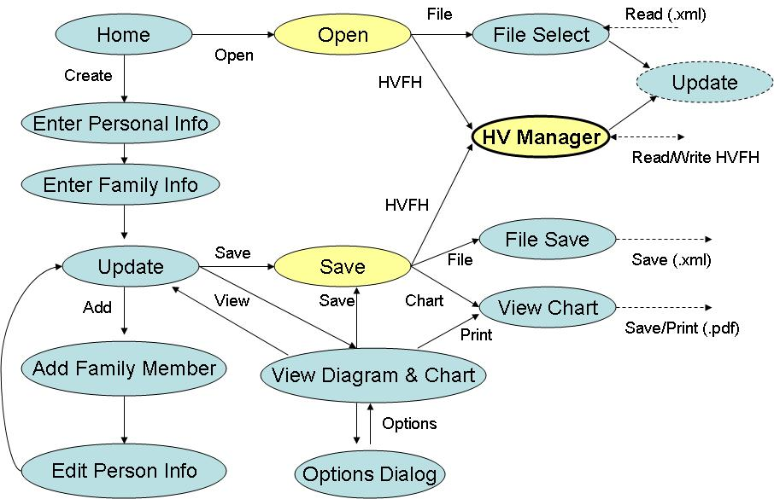
Future navigation map

Slide 11
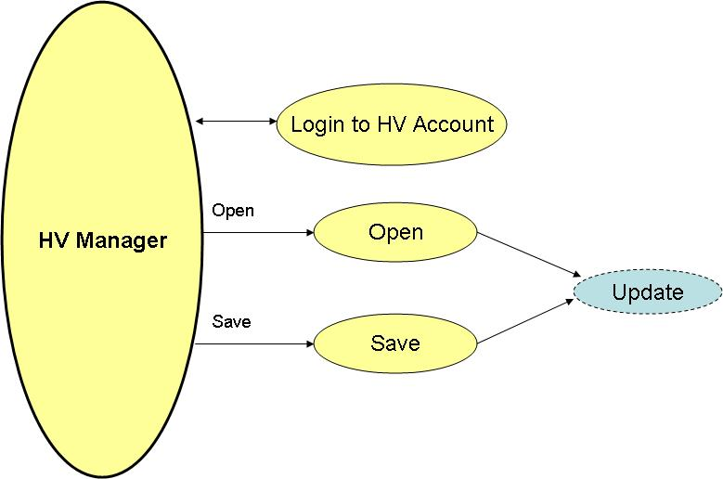
HealthVault Manager navigation map

Slide 12
Future screen: UPDATE
. Changes TBD – see Gap Analysis

Slide 13
Future screen: OPEN
.
Similar to current SAVE screen
User presented with options and explanatory text
“Where is your Family Health History stored?”
  As a computer file (XML file)
  As a HealthVault Family History
    Takes user to HealthVault Manager screen

Slide 14
Future screen: OPEN
.

Slide 15
Future screen: SAVE
.
Also similar to current SAVE screen
User presented with options and explanatory text
“Three ways to save your Family Health History”
  As a computer file (XML file)
  As a HealthVault Family History
    Takes user to HealthVault Manager screen
  As a visual chart file (PDF file)
    Design consideration: this is a dead end – not saving in a format that can be read back in
    Consider separate Print Options section

Slide 16
Future screen: SAVE
.

Slide 17
Future screen: HEALTHVAULT MANAGER
.
One-stop shop for HealthVault integration
User presented with options and explanatory text
Log in to existing account
Open/Save family history
Error conditions handled (Use Case alternative flows)
  Invalid account credentials
  timeouts
  etc. etc. etc…
Translation Issues (much to discuss…)

Slide 18
Future screen: HEALTHVAULT MANAGER
.

Slide 19
Design Notes: HEALTHVAULT MANAGER
.
Format translation & file I/O should be separate modules
Translation modules:
  One for MFHP → HealthVault
  One for HealthVault → MFHP
  XML strings as input and output? (implementation issue)
  Has object model for both formats
  Translates everything it can
  How to handle everything else?
    Ignore?
    Flag warnings/errors?
    Create stubs whenever possible?
    Guide user through correction process?

Slide 20
Design Notes: HEALTHVAULT MANAGER
.
See Special Requirements #2, Import Use Case: “HealthVault family history attributes/fields which do not have a corresponding attribute/field in MFHP shall not be imported into MFHP.”
No similar requirement for Export – why? Are we sure everything can be exported?
Do we want to consider fixing translation issues?

Slide 21
Design Notes: FIXING TRANSLATION PROBLEMS
.
How should ambiguity be handled?
  Ignore & handle in future release?
  Report it & let user handle manually?
  Have a Wizard walk user thru correction steps?
    “Disambiguation dialog”
    “Which uncle had Crohn’s Disease? (Joe or Henry)
How should condition mapping be handled?
  Automatic table-driven conversion?
  Report it & let user handle manually?
  Wizard? – ask user to choose among possible mappings
    “Please choose an alternate description for <condition>”
    Provide menu of alternate values in the target object model

Slide 22
Risks
.
Format translation
  Greater risk than the user interface
  Many cases to consider in translating between MFHP and HV formats – prone to difficult-to-find problems
  Could be hard to know when we’re done.
Coordination with Microsoft
HealthVault file features could be hard to integrate
HealthVault connection could be slow

Slide 23
Next Steps
.
TBD at next sprint planning exercise.
Format translation tasks include:
  Schedule a format translation envision session
  Define several test family histories
    In MFHP format
    In HealthVault format
  Create XML files for each history
  Design format translation test harness
User Interface tasks include
  Create wireframes
    Save file
    Open file

